Slide 1
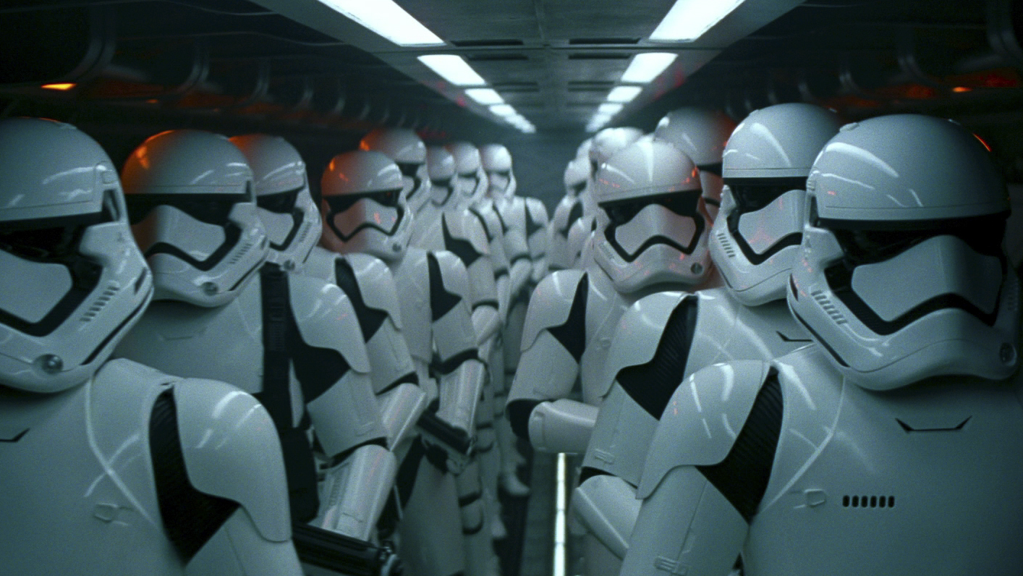
FRONTLINE UPDATES
ASC FUTURE PRACTICES

Slide 2
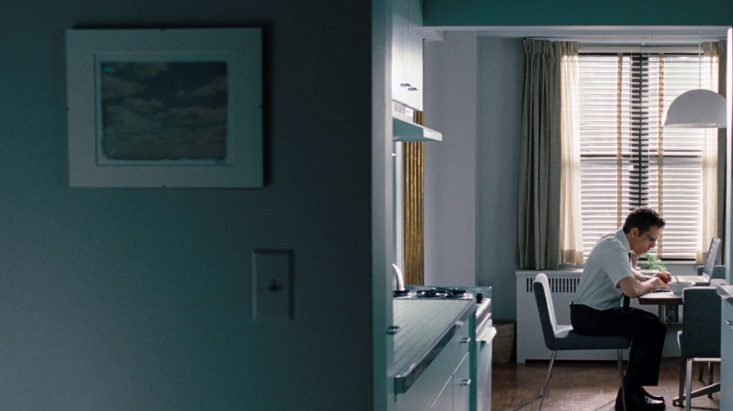
“Covid” Commercials April into June
•Consultation time needed to talk through the process, gear & protocols, even before the “prep” period starts.
• New workflows and tech challenges for DIT’s and crews to manage.
• Extra prep & testing time needed to work out bugs or issues.
• Strong WiFi and cell signals needed to handle all the new demands.
• Virtual Scouting to help keep department heads separate.
“I don’t ever want to do that again!”
Fellow ASC DP

Slide 3
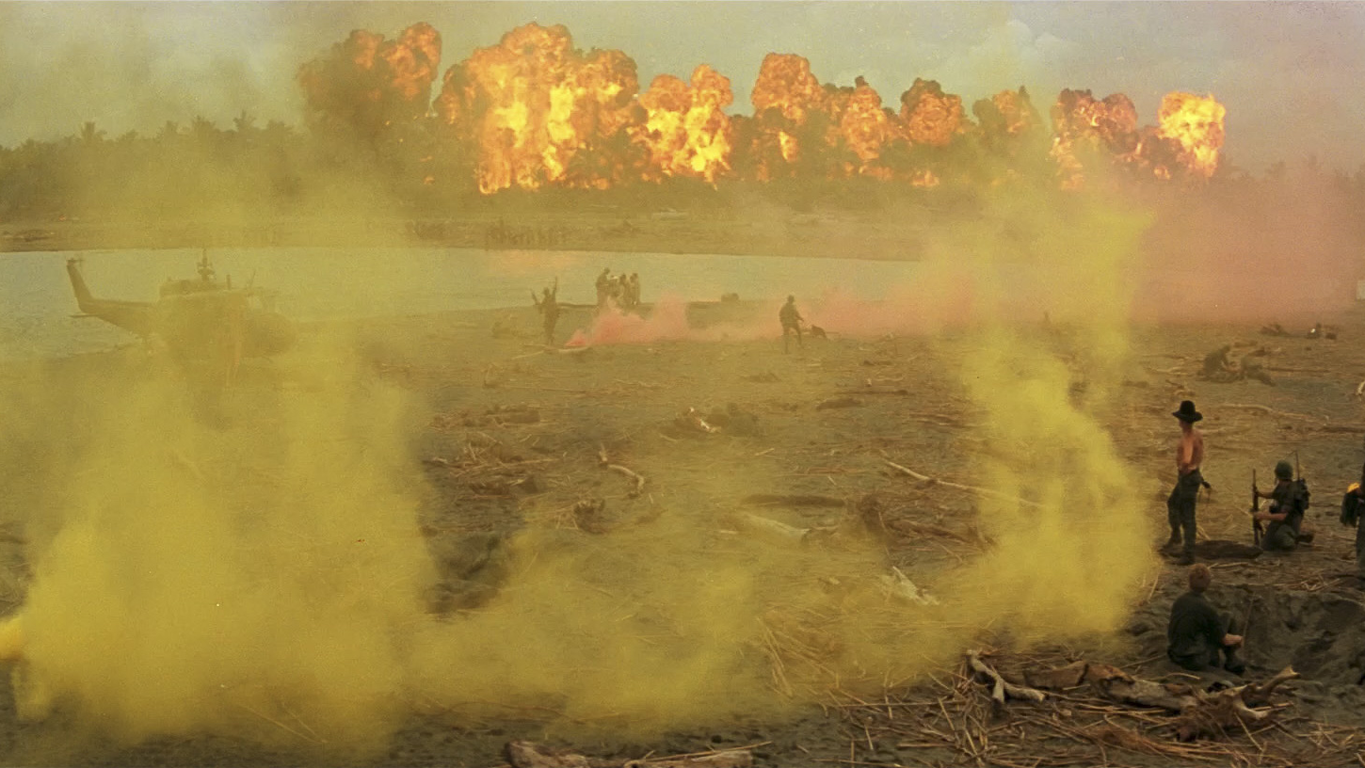
Movies at the beginning of a Pandemic…
DP Bergsteinn Björgúlfsson (Besti), shot a Netflix show in Iceland early in the pandemic. The cases of Covid were very low and the protocols were still being developed.
DP Andrew Rowlands, shot “Children of the Corn” in Australia from May into June. His show set up protocols quickly, some of which we’re all going to be using as we go forward.
“Your plan won’t survive DAY ONE because people are unpredictable…. Someone will lie on the questionnaire or not follow rules. You need to be ready to adapt. ” – 1st AD “Children of the Corn”

Slide 4
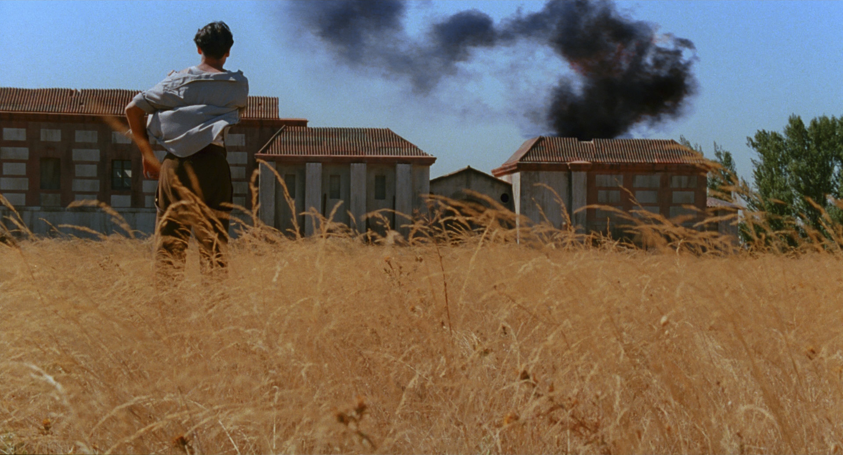
“Children of the Corn” - Key points “No matter how good your protocols, you’re only as strong as your weakest link”. Lucas Foster – Producer
•Plan with safety in mind & then execute safely OR call up the issues.
•Every script and every scene will need its own risk assessment. Sometimes every shot.
•Mandatory “Fresh Air” breaks every 30 minutes for crew to remove masks & get water. Extraction fans turned on.
•People can leave the show, but it may not be possible to replace them. And, that makes it tough to fire anyone.
•At daily safety meetings, remind the crew of their values -- to follow the rules, protect each other and stay safe.
•No crossing of crew or gear between units and no more jumping in to help other departments.
•Department heads need to set good examples for others. Even during non work hours on location.

Slide 5
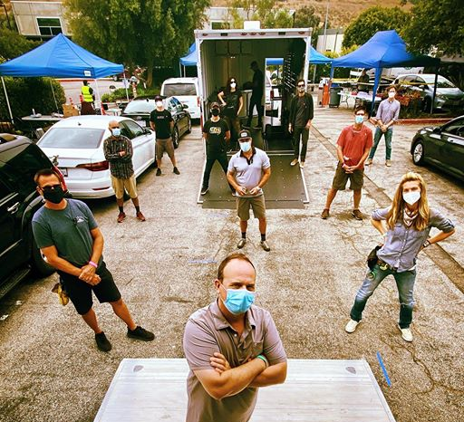
BACK TO “ONE”!
• Good Wifi & Cell service is vital at all locations
•The “Covid Safety Officer” is a new position, & not all are well trained or know a lot about production.
• Speak with the producer, or call the local, if you feel the CSO isn’t up to the task.
• Be your own Safety Officer & encourage your crew to do the same. Look out for each other.
• Place markers or cones at 6’ around camera or monitors if needed to remind people to distance.
“Everyone’s walking around saying “6 feet!” trying to remind each other to keep a distance.”

Slide 6
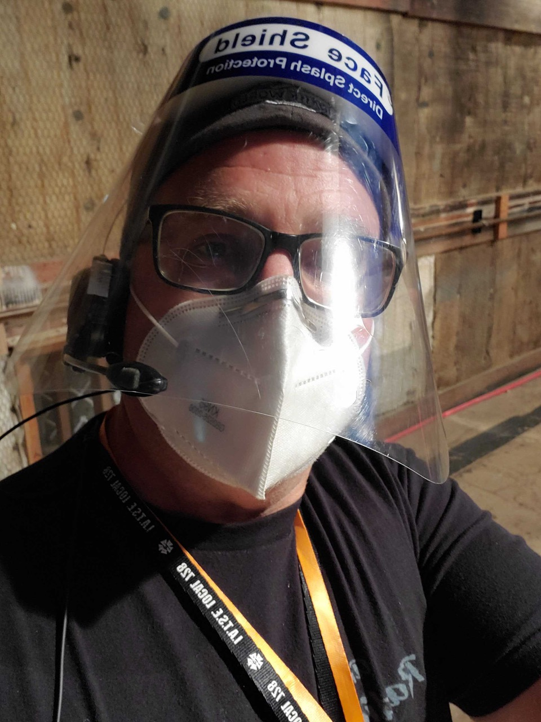
The “New Normal”
• Practice wearing all your PPE before your first day on set.
• Even on scout days, com-systems & walkies will be vital.
• More room for everything! Bigger basecamps & more prep time to determine where all the staging areas will go.
• Open air tents may be safer than trailers or mobile homes.
• Bigger monitor tents, but with fewer people inside.
• Feeding images to iPads or remote monitors off set.
• It’s not always about having “less crew”, but more about “crew management” in order to avoid mixing of pods or units.
• Even staggered lunches will take a lot of time.
• Plastic waste will increase. Encourage producers to use biodegradable items & think about sustainability.
“When the process becomes linear it slows down.
And this is heading into a more linear process.”

Slide 7
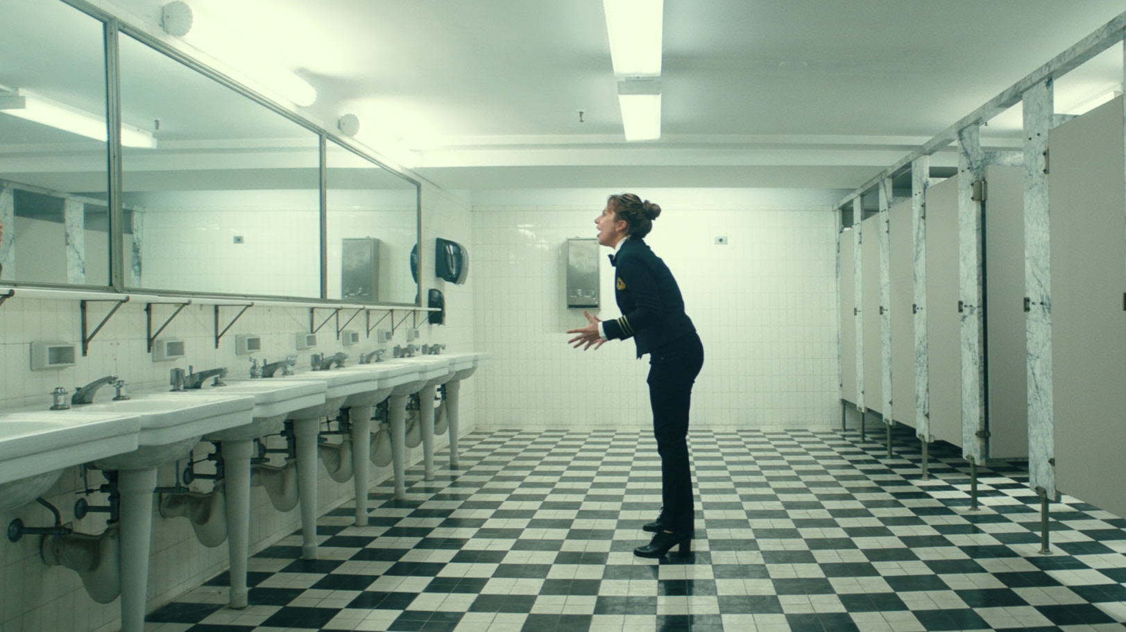
Final thoughts..…
BE PATIENT --
Some crew members may feel stressed as we all get back on set, and it can be a steep learning curve to work within the new restrictions.
It may be hard to hear each other through masks, and things may just take more time. So we’ll all have to work harder to plan things out.
Those who’ve been shooting say: “It does get better!”
And the final good news ---
“The bathrooms are being cleaned much more often!! ”

Slide 8
”Production made me sign an NDA, so I can’t talk about any of the safety protocols that have been enacted.”
A FEW fellow ASC Members
“Covid is stressful & you may need
F****g therapy!”
Fellow ASC Member
“You can theorize all you like about safety protocols, but until you get on set, you don’t really know…But, I can tell you it is impossible to keep a camera crew 1.5 meters apart.”
Lucas Foster, producer
“The Agency wanted witness cameras on set, so they could see from the other room, but I shut that **** down!”
Commerical DP/Dir

